Slide 1


Slide 2


A News Source You Can Trust?

Slide 3
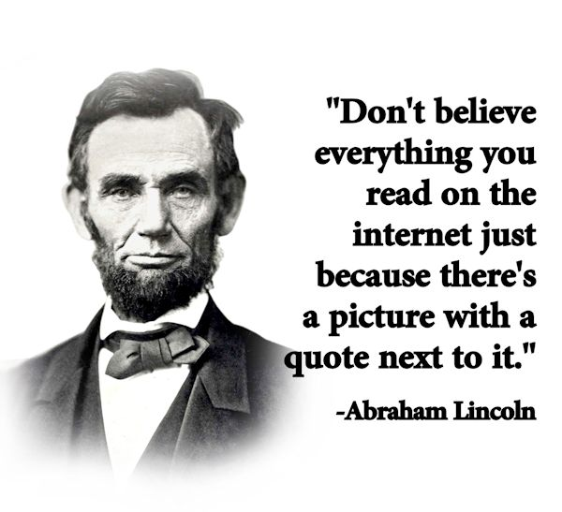
“Fake News”

Slide 4

Wikipedia
“In 2005, Nature published a peer review comparing 42 science articles from Encyclopedia Britannica and Wikipedia, and found that Wikipedia's level of accuracy approached Encyclopedia Britannica's. Criticism of Wikipedia includes claims that it exhibits systemic bias, presents a mixture of ‘truths, half truths, and some falsehoods’, and that in controversial topics, it is subject to manipulation and spin.”

Slide 5
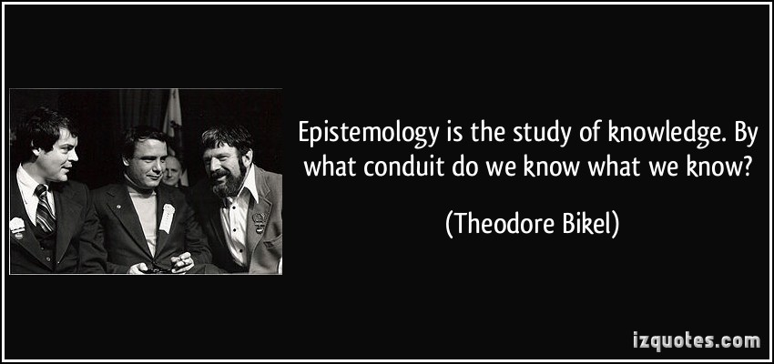
Epistemology

Slide 6
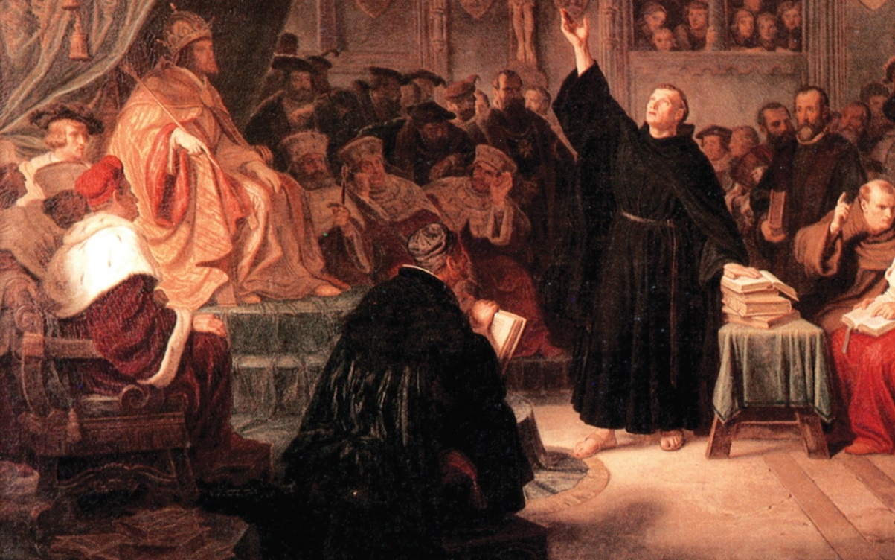
Martin Luther – Scripture Alone
“Unless I am convinced by the testimony of the Scriptures or by clear reason (for I do not trust either in the pope or in councils alone, since it is well known that they have often erred and contradicted themselves), I am bound by the Scriptures I have quoted and my conscience is captive to the Word of God. I cannot and will not recant anything, since it is neither safe nor right to go against conscience. May God help me. Amen.”

Slide 7
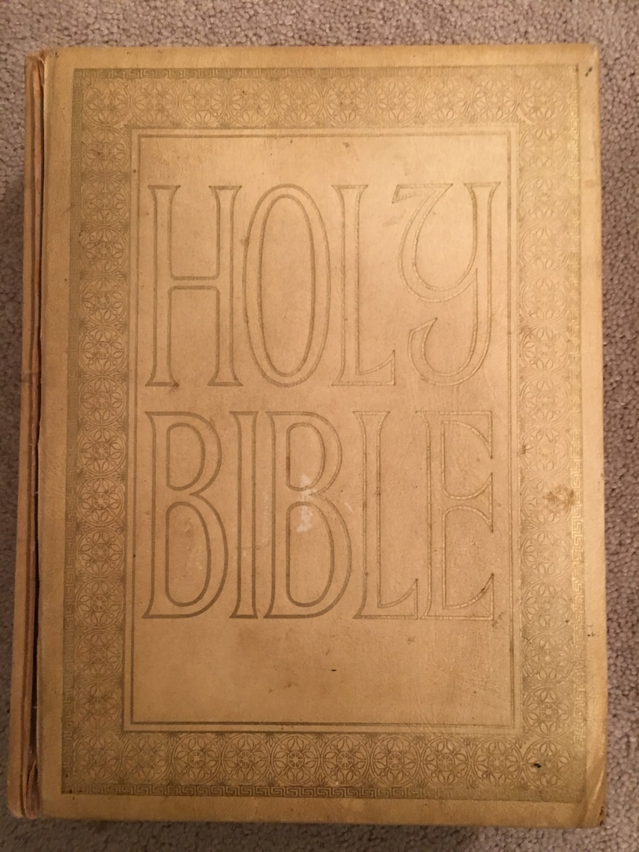
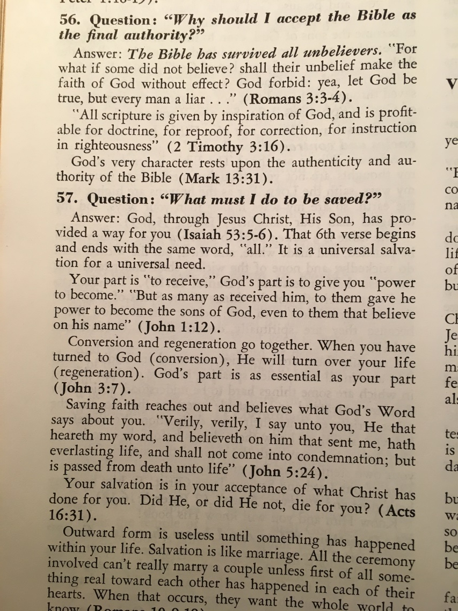
The Bible and My Conversion

Slide 8
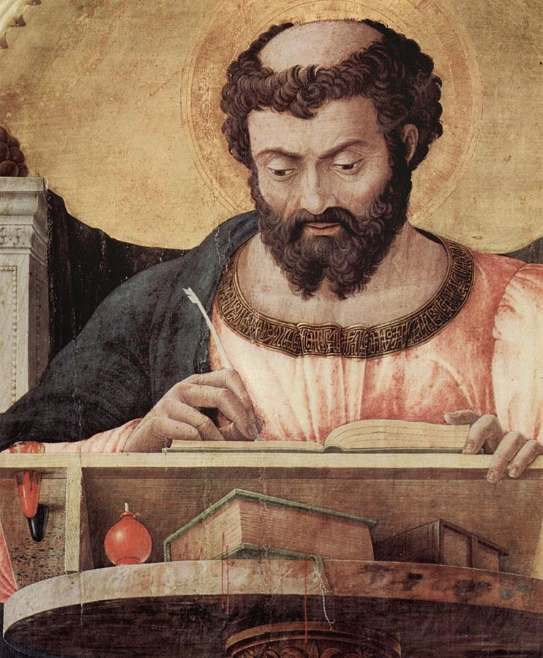
Did Jesus Christ Rise From the Dead?
“Inasmuch as many have undertaken to compile a narrative of the things that have been accomplished among us, just as those who from the beginning were eyewitnesses and ministers of the word have delivered them to us, it seemed good to me also, having followed all things closely for some time past, to write an orderly account for you, most excellent Theophilus, that you may have certainty concerning the things you have been taught.” Luke 1:1-4

Slide 9

Is the Bible a Trustworthy Source?
“What if there’s a way to come to a good and confident conclusion that Jesus really did rise from the dead without presupposing that the Bible is the Word of God? If we could do this, then we’d be able to avoid the charge of unwarranted circularity… Even more, though, than the religions of the world, Christianity presents itself as history. It’s not primarily just a list of ethical teachings or a body of philosophical musings or mystical ‘truths’ or even a compendium of myths and fables. At its very heart, Christianity is a claim that something extraordinary has happened in the course of time – something concrete and real and historical… Are the New Testament documents – and especially, for our purposes, the four Gospels – truly reliable as historical witnesses?”
Greg Gilbert, Why Trust the Bible?

Slide 10

The Chain of Important Questions
Can we trust the translation?
Can we trust the process of transmission?
Can we trust the canon?
Can we trust the original authors?
Can we trust the Bible?

Slide 11
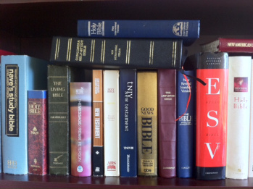
Can We Trust The Translation?

Slide 12
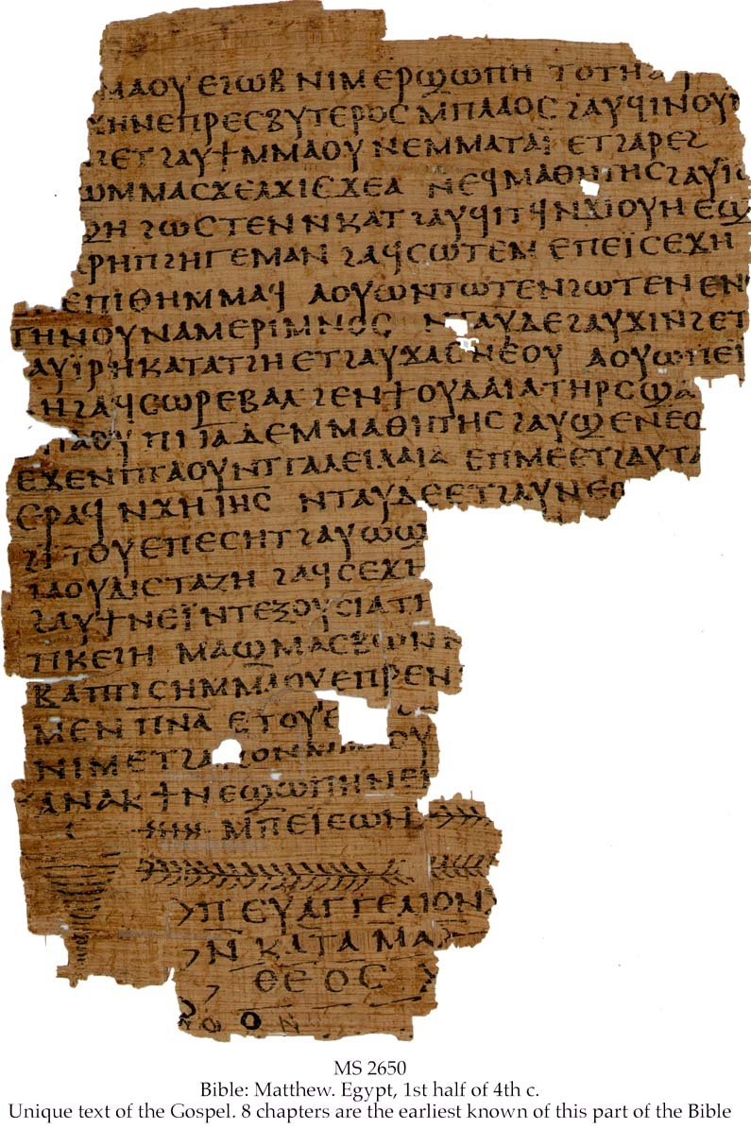
“All Scripture is breathed out by God and profitable for teaching, for reproof, for correction, and for training in righteousness, that the man of God may be competent, equipped for every good work.” II Tim. 3:16
“…no prophecy of Scripture comes from someone's own interpretation. For no prophecy was ever produced by the will of man, but men spoke from God as they were carried along by the Holy Spirit.”
II Peter 1:20,21

Slide 13
Verbal / Plenary Inspiration
“A special act of God in which the Holy Spirit providentially guided the human authors to convey His Word infallibly and without error in all that they affirm in the original manuscripts by using their individual situations and personalities in a proper relationship with the rest of Scripture.”
“verbal” – every word; “plenary” – fully, every part, all that it addresses
“But [Jesus] answered, “It is written, “‘Man shall not live by bread alone, but by every word that comes from the mouth of God.’” Matthew 4:4

Slide 14
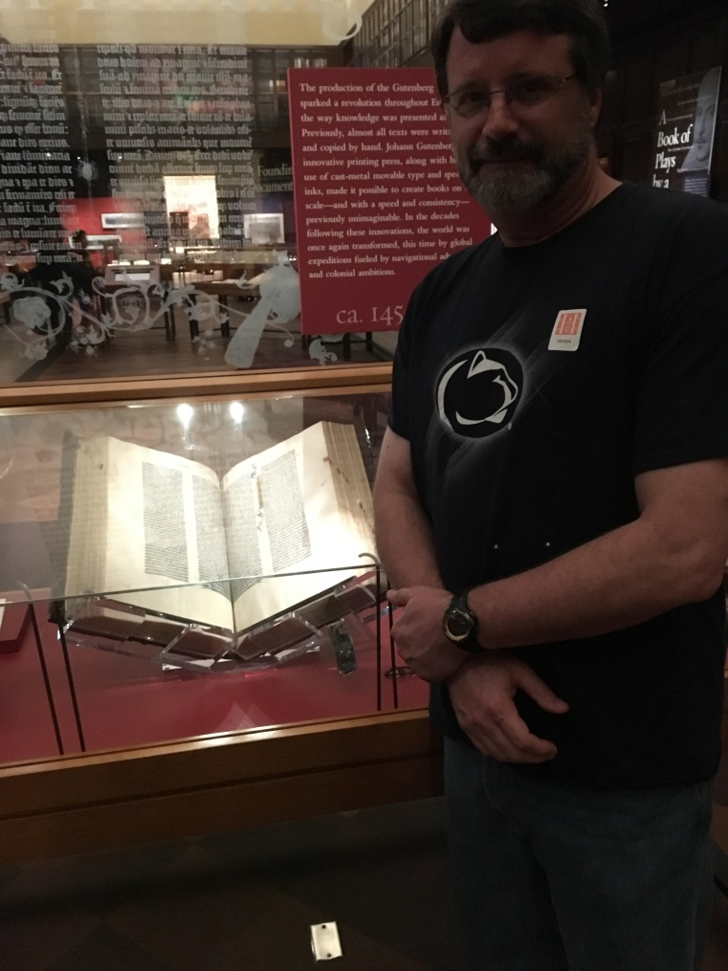
History of English Translations
500 AD: Scriptures translated into over 500 languages.
600 AD: Only Latin translation is allowed for Scripture.
1384 AD: Wycliffe is the first person to produce a hand-written copy of the complete Bible in English
1455 AD: Gutenberg invents the printing press; books may now be mass-produced instead of individually hand-written. The first book ever printed is Gutenberg's Bible in Latin.

Slide 15
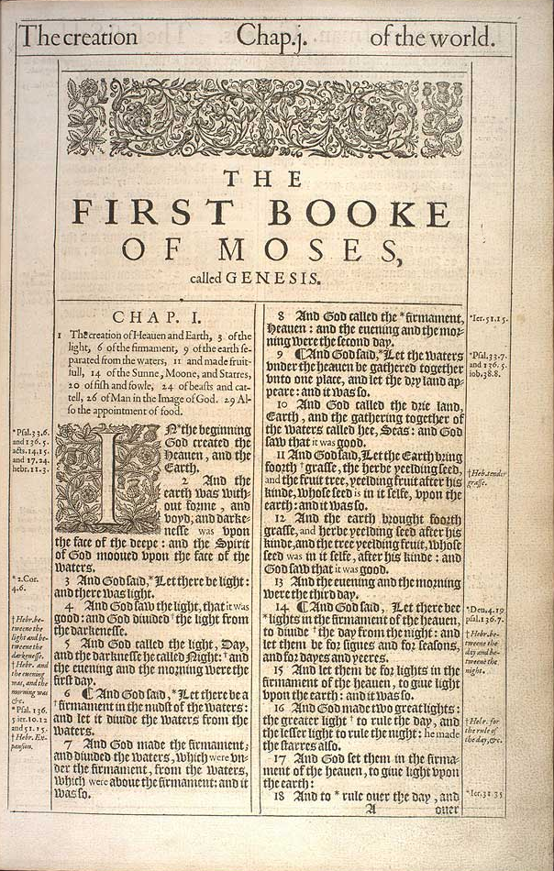
1522 AD: Martin Luther's German New Testament.
1526 AD: William Tyndale's New Testament; the first New Testament printed in the English language.
1535 AD: Myles Coverdale's Bible; the first complete Bible printed in the English language
1560 AD: The Geneva Bible printed; the first English language Bible to add numbered verses to each chapter; Reformed study notes
1611 AD: The King James Bible printed

Slide 16
1901 AD: The American Standard Version is published; the first major American revision of the KJV.
1971 AD: The New American Standard Bible (NASB) is published as a “modern and accurate word for word English translation" of the Bible.
1973 AD: The New International Version (NIV) is published as a “modern and accurate phrase for phrase English translation" of the Bible.
1982 AD: The New King James Version (NKJV) is published as a “modern English version maintaining the original style of the King James."
2002 AD: The English Standard Version (ESV) is published as a translation to bridge the gap between the accuracy of the NASB and the readability of the NIV.

Slide 17
More than 450 English Translations
“If significantly disputed portions of the text are so rare and if they don’t affect any major doctrines, then why have people gone to so much expense and trouble to make all those translations? …That’s the main reason we have different translations – for different uses of the Bible. Sometimes a stricter, more word-for-word translation of the original language is exactly what you need. But at other times, you want something a bit more readable, a bit more readily understandable, and so some translations offer a more phrase-for-phrase (or even thought-for-thought) approach, smoothing out word order, preferring English syntax over Greek or Hebrew syntax, and generally just rendering the thoughts of the original in a form that an English-speaking reader will better understand.”
Greg Gilbert, Why Trust the Bible?

