Slide 1

Oakwood Presbyterian Church

Slide 2
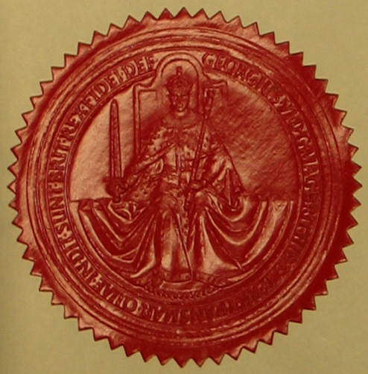
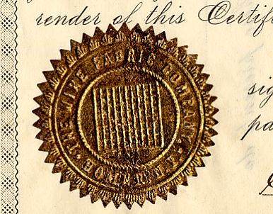
The Sacraments: Signs and Seals of the Covenant of Grace
“I will take you to be My people, and I will be your God.” Exodus 6:7

Slide 3


Slide 4

The New Covenant Community
“ Know then that it is those of faith who are the sons of Abraham… in Christ Jesus you are all sons of God, through faith. For as many of you as were baptized into Christ have put on Christ. There is neither Jew nor Greek, there is neither slave nor free, there is no male and female, for you are all one in Christ Jesus. And if you are Christ's, then you are Abraham's offspring, heirs according to promise.” Galatians 3:7, 26-29

Slide 5
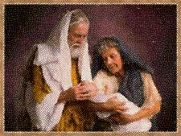
The Sign of Inclusion
”This is My covenant, which you shall keep, between me and you and your offspring after you: Every male among you shall be circumcised. You shall be circumcised in the flesh of your foreskins, and it shall be a sign of the covenant between Me and you… So shall My covenant be in your flesh an everlasting covenant.” Genesis 17:10-13

Slide 6
Visible / Invisible Church

Slide 7
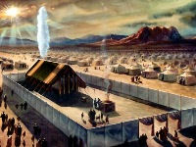
The Marks of Belonging to the Visible Covenant Community
“I will be your God, and you will be My people.”
Circumcision Baptism
Passover The Lord’s Supper

Slide 8

Baptism
Old Testament “washings”
John the Baptist
“And Jesus came and said to them, ‘All authority in heaven and on earth has been given to Me. Go therefore and make disciples of all nations, baptizing them in the name of the Father and of the Son and of the Holy Spirit…’” Matt. 28:18,19

Slide 9

Definitions
“Sacrament” – “A sacrament is a holy ordinance instituted by Christ; wherein, by sensible signs, Christ, and the benefits of the new covenant, are represented, sealed, and applied to believers.” W.S.C., Question #92
“Sign” - something that indicates or acts as a token of a fact, condition, etc, that is not immediately or outwardly observable
“Seal” - an embossed emblem, figure, symbol, word, letter, etc., used as attestation or evidence of authenticity.

Slide 10

The Meaning of Circumcision: Circumcision of the Heart
Regeneration - “And the Lord your God will circumcise your heart and the heart of your offspring, so that you will love the Lord your God with all your heart and with all your soul, that you may live.” Deuteronomy 30:6
Repentance / Forgiveness - “Circumcise yourselves to the Lord; remove the foreskin of your hearts, O men of Judah and inhabitants of Jerusalem; lest My wrath go forth like fire, and burn with none to quench it, because of the evil of your deeds…O Jerusalem, wash your heart from evil, that you may be saved.” Jeremiah 4:4,14

Slide 11
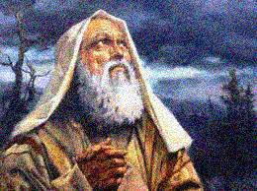
Circumcision of the Heart (cont.)
Justification by Faith Alone - “Is this blessing then only for the circumcised, or also for the uncircumcised? For we say that faith was counted to Abraham as righteousness. How then was it counted to him? Was it before or after he had been circumcised? It was not after, but before he was circumcised. He received the sign of circumcision as a seal of the righteousness that he had by faith while he was still uncircumcised. The purpose was to make him the father of all those who believe without being circumcised…” Romans 4:9-11

Slide 12
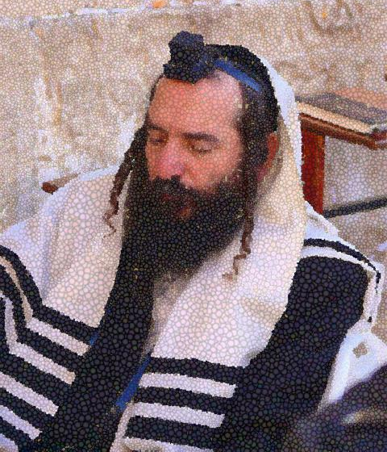
Circumcision of the Heart (cont.)
Election / Adoption - “For no one is a Jew who is merely one outwardly, nor is circumcision outward and physical. But a Jew is one inwardly, and circumcision is a matter of the heart, by the Spirit, not by the letter. His praise is not from man but from God.” Romans 2:28,29

Slide 13

Circumcision of the Heart Baptism
“In [Christ] also you were circumcised with a circumcision made without hands, by putting off the body of the flesh, by the circumcision of Christ, having been buried with Him in baptism, in which you were also raised with Him through faith in the powerful working of God, who raised Him from the dead. And you, who were dead in your trespasses and the uncircumcision of your flesh, God made alive together with Him, having forgiven us all our trespasses…” Colossians 2:11,12

Slide 14
The Meaning of Baptism
“Baptism is a sacrament of the New Testament, wherein Christ hath ordained the washing with water in the name of the Father, and of the Son, and of the Holy Ghost, to be a sign and seal of ingrafting into Himself, of remission of sins by His blood, and regeneration by His Spirit; of adoption and resurrection unto everlasting life; and whereby the parties baptized are solemnly admitted into the visible church, and enter into an open and professed engagement to be wholly and only the Lord’s.”
Westminster Larger Catechism, Question #165

Slide 15

A Picture of God’s Total Work of Grace
A sign of…
  Union with Christ
  Forgiveness of Sins (Cleansing)
  Regeneration
  Adoption
  Resurrection
Union with Christ / Regeneration / Repentance - “Do you not know that all of us who have been baptized into Christ Jesus were baptized into His death? We were buried therefore with Him by baptism into death, in order that, just as Christ was raised from the dead by the glory of the Father, we too might walk in newness of life. For if we have been united with Him in a death like His, we shall certainly be united with Him in a resurrection like His. ” Romans 6:3-5

Slide 16

A Picture of God’s Work of Grace (cont.)
Forgiveness / Cleansing – “And Peter said to them, “Repent and be baptized every one of you in the name of Jesus Christ for the forgiveness of your sins…” Acts 2:38; “Rise and be baptized and wash away your sins, calling on His name.” Acts 22:16
Adoption / Union with Christ – “…in Christ Jesus you are all sons of God, through faith. For as many of you as were baptized into Christ have put on Christ.” Galatians 3:27,28

Slide 17
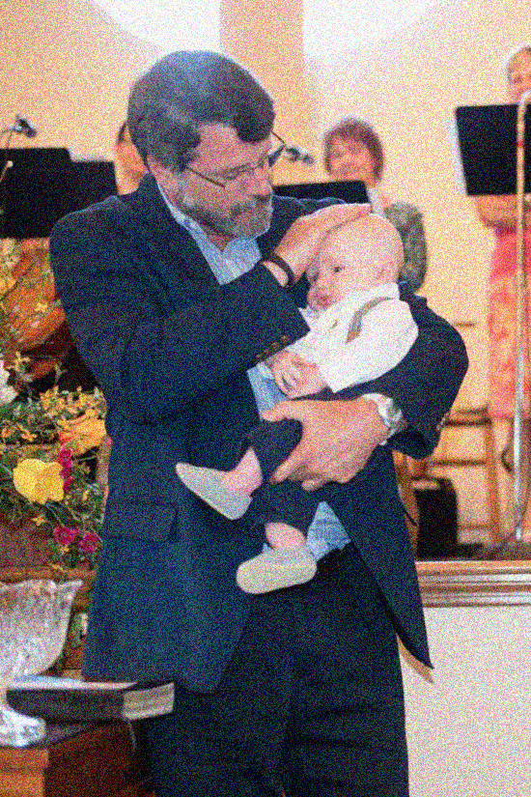
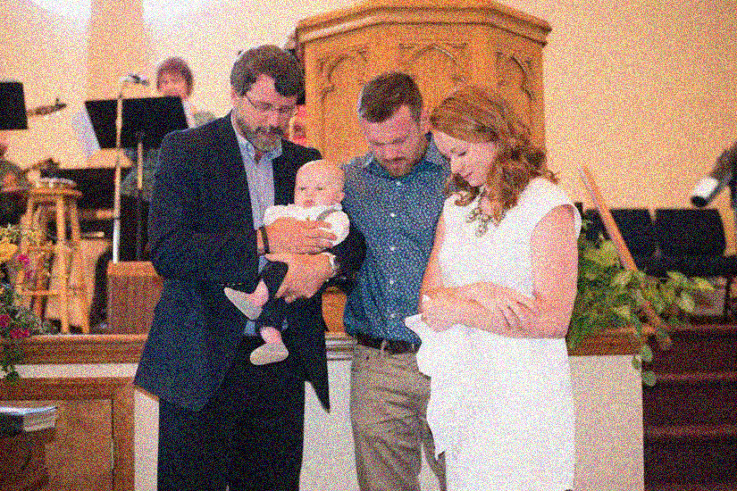
Who Should Receive Baptism?
“And I will establish My covenant between Me and you and your offspring after you throughout their generations for an everlasting covenant, to be God to you and to your offspring after you.” Genesis 17:7
“Repent and be baptized every one of you in the name of Jesus Christ for the forgiveness of your sins, and you will receive the gift of the Holy Spirit. For the promise is for you and for your children and for all who are far off, everyone whom the Lord our God calls to Himself.” Acts 2:38,39

Slide 18

Household Baptisms
“The Lord opened [Lydia’s] heart to pay attention to what was said by Paul. And after she was baptized, and her household as well…” Acts 16:14,15
“ And [Paul and Silas] said, “Believe in the Lord Jesus, and you will be saved, you and your household’… and [the jailor] was baptized at once, he and all his family.” Acts 16:31-33
“I did baptize also the household of Stephanas. Beyond that, I do not know whether I baptized anyone else.” I Corinthians 1:16
“If any woman has a husband who is an unbeliever, and he consents to live with her, she should not divorce him. For the unbelieving husband is made holy because of his wife, and the unbelieving wife is made holy because of her husband. Otherwise your children would be unclean, but as it is, they are holy.” I Corinthians 7:13,14

Slide 19

Household Baptisms
“That makes a total of nine people in the New Testament who are mentioned by name as having been baptized…Of the nine persons…two probably didn’t have immediate families – Saul and the Ethiopian eunuch. We are not informed about any family of two others, Simon Magus and Gaius…in every case where the apostles administered baptism to the known head of a family, they also administered it to his entire household.”
Robert R. Booth,
Children of the Promise

Slide 20
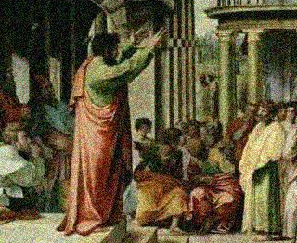
The Missing Controversy
Hypothetical: If there is even just a similarity between circumcision and baptism in their meanings and roles as signs of the covenant, and if the Apostles were instructed to only administer the sign of baptism to those who professed faith, then why is there no hint of a controversy in the book of Acts or in the NT epistles about whether or not baptism should be given to the children of believers?
Inquiring Jewish minds would want to know!

Slide 21
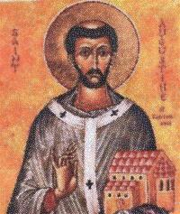
Church History
Evidence of church practice in the first few centuries of the church is scant at best.
The writings of the early church fathers reveal a variety of views about baptism, but they also indicate that infant baptism was the common practice.
Samuel Miller: Paedobaptism was virtually universal for the first 1500 years of the church, and was embraced by the principle theologians of the Protestant Reformation.

