Slide 1
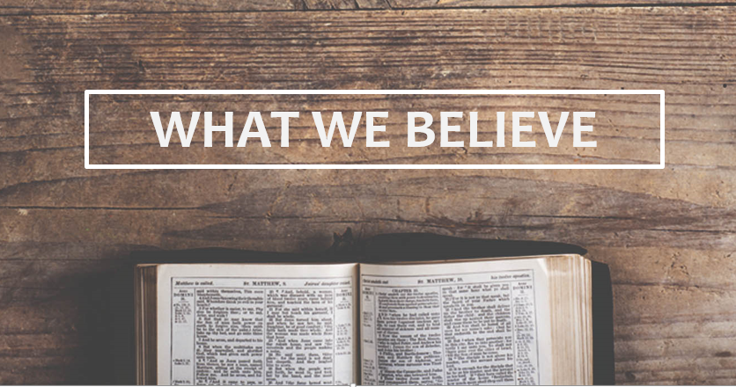
Oakwood Presbyterian Church

Slide 2
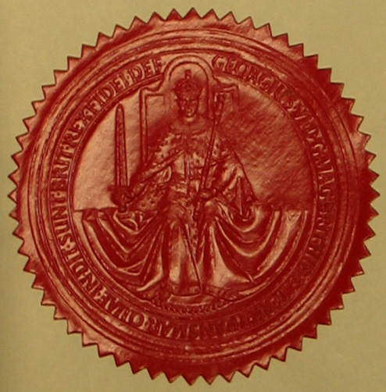
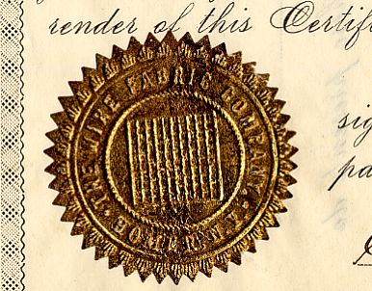
The Sacraments: Signs and Seals of the Covenant of Grace, Part II
“I will take you to be My people, and I will be your God.” Exodus 6:7

Slide 3
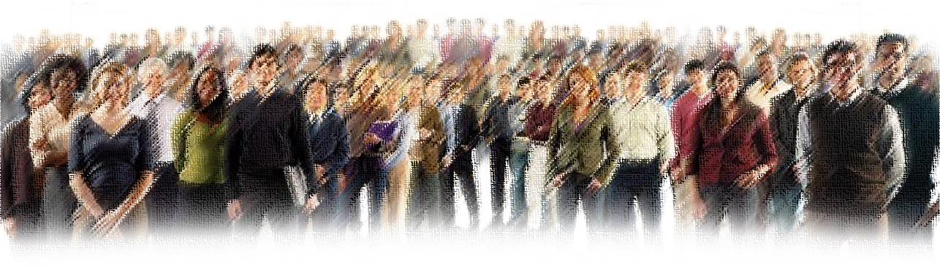
The New Covenant Community
“ Know then that it is those of faith who are the sons of Abraham… in Christ Jesus you are all sons of God, through faith. For as many of you as were baptized into Christ have put on Christ. There is neither Jew nor Greek, there is neither slave nor free, there is no male and female, for you are all one in Christ Jesus. And if you are Christ's, then you are Abraham's offspring, heirs according to promise.” Galatians 3:7, 26-29

Slide 4
Visible / Invisible Church

Slide 5
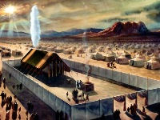
The Marks of Belonging to the Visible Covenant Community
“I will be your God, and you will be My people.”
Circumcision Baptism
Passover The Lord’s Supper

Slide 6
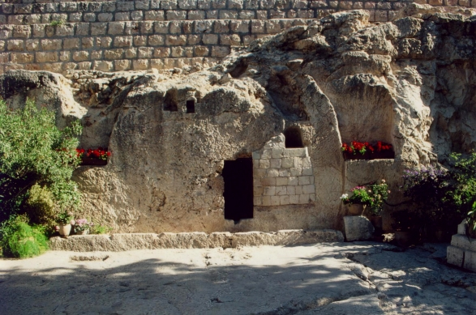
Buried and Raised With Christ
“We were buried therefore with Him by baptism into death, in order that, just as Christ was raised from the dead by the glory of the Father, we too might walk in newness of life.” Romans 6:4

Slide 7
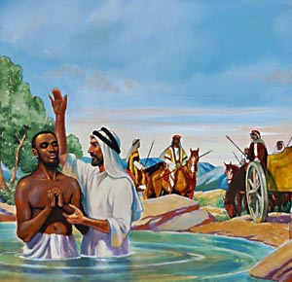
What Actually Happened?
”And [Philip] commanded the chariot to stop, and they both went down into the water, Philip and the eunuch, and he baptized him. And when they came up out of the water, the Spirit of the Lord carried Philip away, and the eunuch saw him no more, and went on his way rejoicing.”
Acts 8:38,39

Slide 8
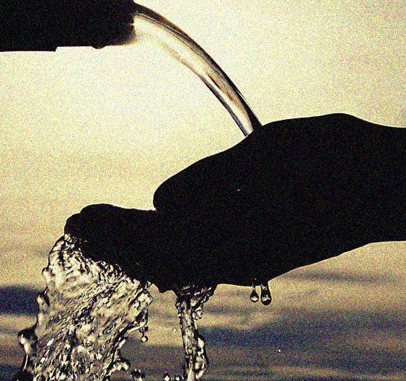
The Meaning of baptizw
The Greek word for “baptism” can possibly mean “to immerse”, but it seldom means that in the Greek Bible (the Septuagint and New Testament).
Some of the Scriptural meanings: washing, sprinkling, dipping, pouring
As it represents the saving work of the Spirit, having the water poured out is appropriate; as it represents cleansing with blood, sprinkling is appropriate

Slide 9
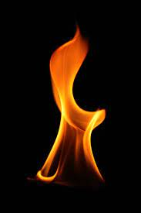
The Pouring Out of the Spirit
“…wait for the promise of the Father… you will be baptized with the Holy Spirit not many days from now.” Acts 1:4,5
“…divided tongues as of fire appeared to them and rested on each one of them. And they were all filled with the Holy Spirit… And in the last days it shall be, God declares, that I will pour out my Spirit on all flesh…” Acts 2:3,17

Slide 10
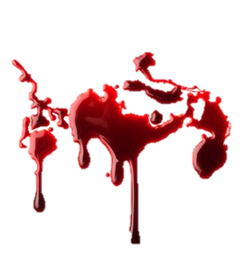
The Sprinkling of the Blood
Hebrews 9:10 refers to OT cleansing rituals as “various washings” (“baptisms”) – then vs. 13 specifically says, “For if the blood of goats and bulls, and the sprinkling of defiled persons with the ashes of a heifer, sanctify for the purification of the flesh, how much more will the blood of Christ, who through the eternal Spirit offered Himself without blemish to God, purify our conscience from dead works to serve the living God.”
“[Moses] took the blood of calves and goats, with water and scarlet wool and hyssop, and sprinkled both the book itself and all the people, saying, ‘This is the blood of the covenant that God commanded for you.’” Hebrews 9:19,20

Slide 11
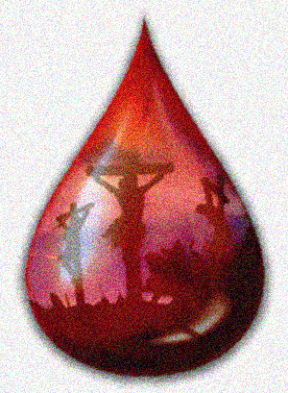
The Blood that Cleanses
“…let us draw near with a true heart in full assurance of faith, with our hearts sprinkled clean from an evil conscience and our bodies washed with pure water.” Hebrews 10:22
We have come “to Jesus, the mediator of a new covenant, and to the sprinkled blood that speaks a better word than the blood of Abel.” Hebrews 12:24

Slide 12
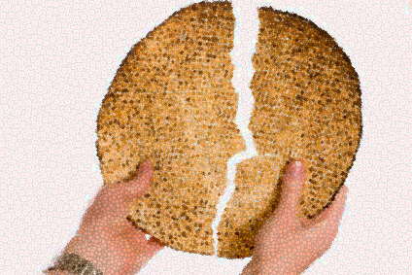
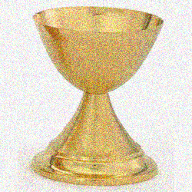
The Lord’s Supper
Instituted by Christ
“For I received from the Lord what I also delivered to you, that the Lord Jesus on the night when he was betrayed took bread, and when He had given thanks, He broke it, and said, ‘This is My body which is for you. Do this in remembrance of Me.’ In the same way also He took the cup, after supper, saying, ‘This cup is the new covenant in My blood. Do this, as often as you drink it, in remembrance of Me.’” I Corinthians 11:23-25
Purpose
“The Lord’s Supper is a sacrament, wherein, by giving and receiving bread and wine, according to Christ’s appointment, His death is showed forth; and the worthy receivers are, not after a corporal and carnal manner, but by faith, made partakers of His body and blood, with all His benefits, to their spiritual nourishment, and growth in grace.” Westminster Shorter Catechism, Question #96

Slide 13
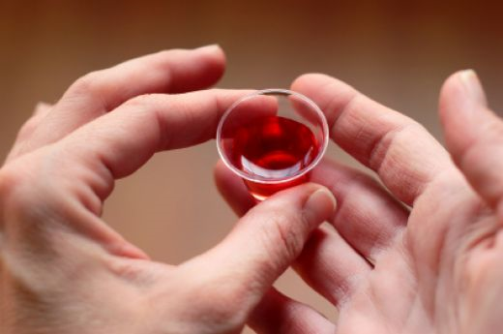
The Presence of the Lord in the Lord’s Supper –
“This is My body…This is My blood…”
Transubstantiation
  literal transformation
Consubstantiation
  “In, with, under” the elements
Spiritual Presence
  “means of grace”
Memorial

Slide 14
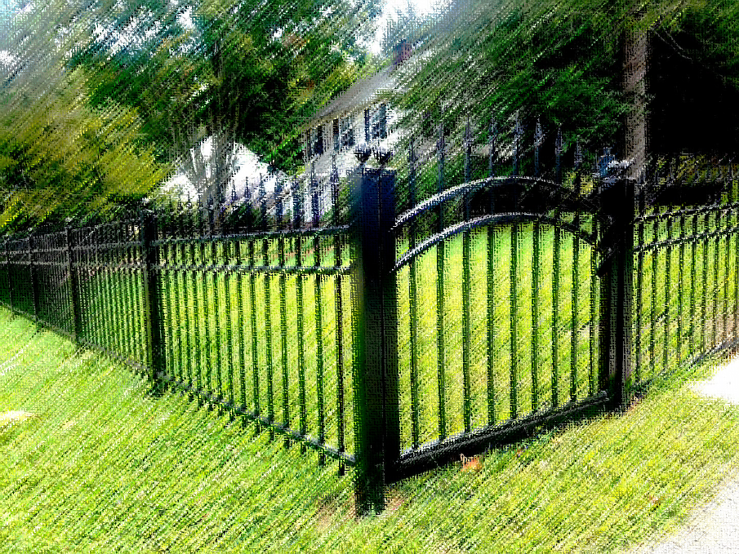
The Purity of the Table
“Fencing the Table”
  “Whoever, therefore, eats the bread or drinks the cup of the Lord in an unworthy manner will be guilty concerning the body and blood of the Lord. Let a person examine himself, then, and so eat of the bread and drink of the cup. For anyone who eats and drinks without discerning the body eats and drinks judgment on himself.” I Corinthians 11:27-29

Slide 15
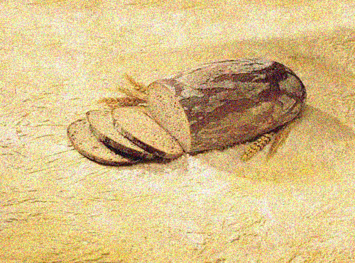
The Lord’s Table and Church Discipline
“Excommunication”:
“When you are assembled in the name of the Lord Jesus and my spirit is present, with the power of our Lord Jesus, you are to deliver this man to Satan… Do you not know that a little leaven leavens the whole lump? Cleanse out the old leaven that you may be a new lump, as you really are unleavened. For Christ, our Passover lamb, has been sacrificed. Let us therefore celebrate the festival, not with the old leaven, the leaven of malice and evil, but with the unleavened bread of sincerity and truth…But now I am writing to you not to associate with anyone who bears the name of brother if he is guilty of sexual immorality or greed, or is an idolater, reviler, drunkard, or swindler - not even to eat with such a one.” I Cor. 5:4-8, 11

Slide 16
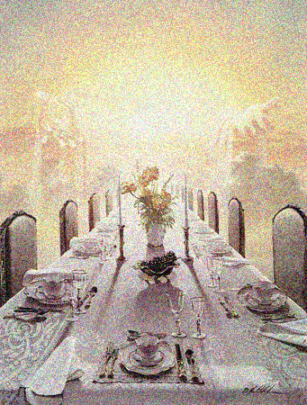
The Future Feast
“For as often as you eat this bread and drink the cup, you proclaim the Lord's death until He comes.”
I Corinthians 11:26
“Then I heard what seemed to be the voice of a great multitude, like the roar of many waters and like the sound of mighty peals of thunder, crying out,
‘Hallelujah!
For the Lord our God
the Almighty reigns.
Let us rejoice and exult
and give Him the glory,
for the marriage of the Lamb has come,
and His Bride has made herself ready;
it was granted her to clothe herself
with fine linen, bright and pure’—
for the fine linen is the righteous deeds of the saints.
And the angel said to me, ‘Write this: Blessed are those who are invited to the marriage supper of the Lamb.’” Revelation 19:6-9

