Slide 1

Oakwood Presbyterian Church

Slide 2
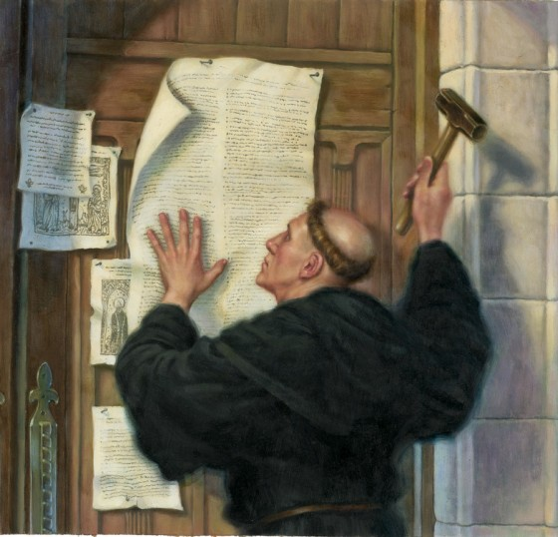
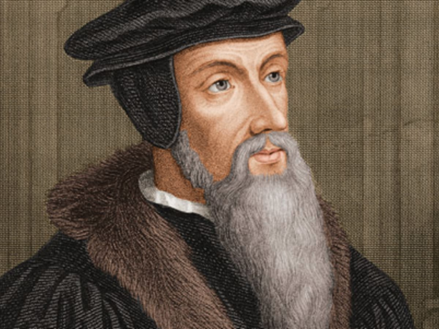

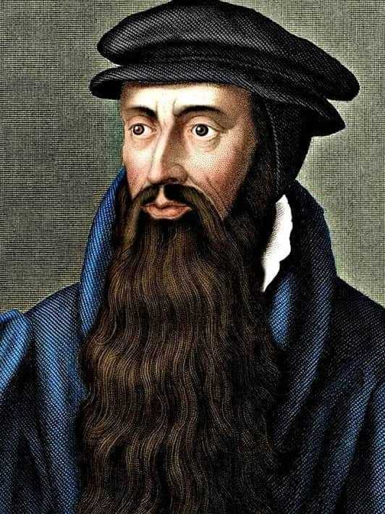
Who We Are, By God’s Grace
Oakwood is Protestant
Oakwood is Evangelical
Oakwood is Reformed
Oakwood is Presbyterian

Slide 3
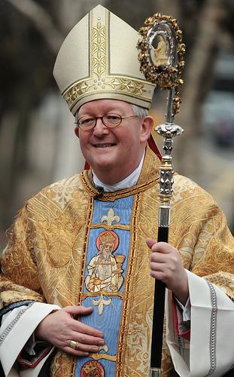
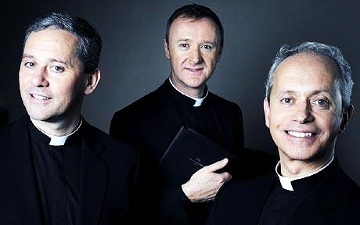
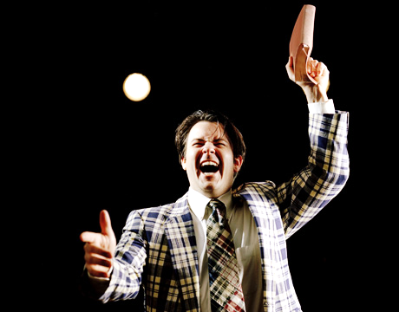
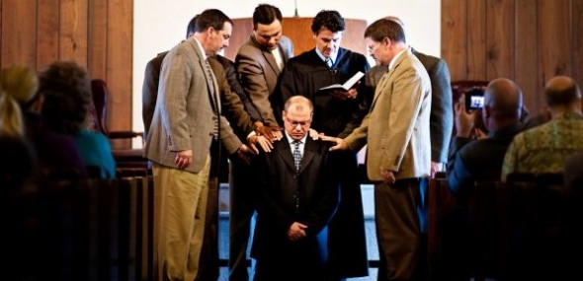
Oakwood is Presbyterian…
Three Types of
Church Government
Hierarchical
Roman Catholic, Anglican, Episcopal, Orthodox, Methodist
Congregational
Baptist, Independent, Non-Denominational
Presbyterian

Slide 4
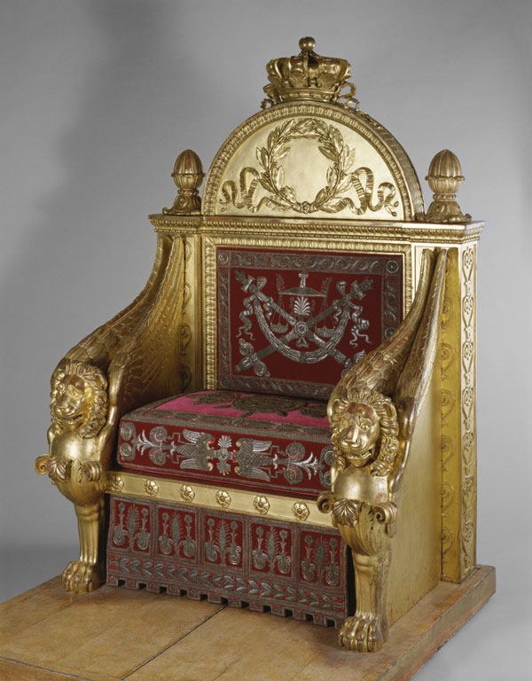
Who’s In Charge?
“…He raised [Christ] from the dead and seated him at his right hand in the heavenly places, far above all rule and authority and power and dominion…And He put all things under His feet and gave Him as head over all things to the church, which is His body, the fullness of Him who fills all in all.” Ephesians 1:20-23
Jesus Christ is our Prophet, Priest, & King
And [Christ] gave the apostles, the prophets, the evangelists, the shepherds and teachers, to equip the saints for the work of ministry, for building up the body of Christ…” Ephesians 4:11,12

Slide 5
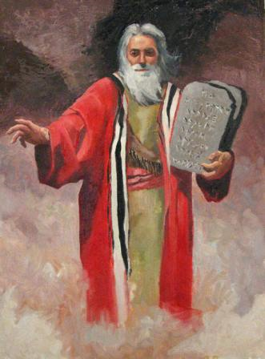
Presbyterianism – Rule by Elders
“So Moses came and called the elders of the people and set before them all these words that the Lord had commanded him.” Exodus 19:7
“Then the king [Josiah] sent, and all the elders of Judah and Jerusalem were gathered to him.” II Kings 23:1
“Then those who had seized Jesus led him to Caiaphas the high priest, where the scribes and the elders had gathered.”
Matthew 26:57
“Now from Miletus [Paul] sent to Ephesus and called the elders of the church to come to him.” Acts 20:17

Slide 6
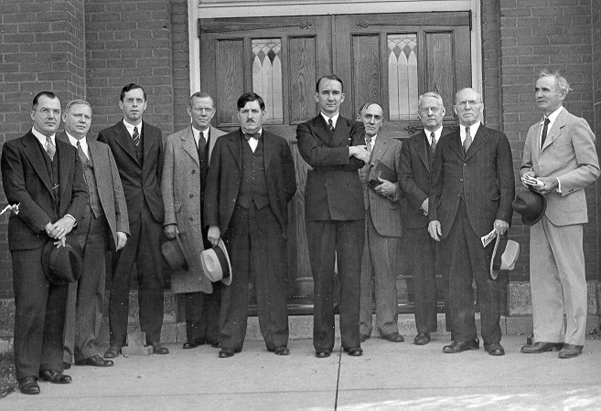
Plurality of Elders
“And when [Paul and Barnabas] had appointed elders for them in every church, with prayer and fasting they committed them to the Lord in whom they had believed.” Acts 14:23
“Is anyone among you sick? Let him call for the elders of the church, and let them pray over him…” James 5:14

Slide 7
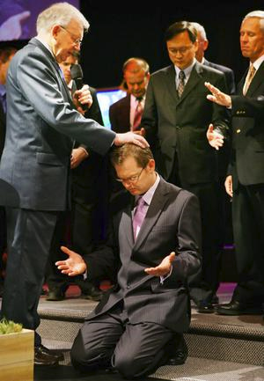
Parity of Elders
“This is why I left you in Crete, so that you might put what remained into order, and appoint elders in every town as I directed you – if anyone is above reproach… For an overseer, as God's steward, must be above reproach.” Titus 1:5-7
“So I exhort the elders among you, as a fellow elder and a witness of the sufferings of Christ, as well as a partaker in the glory that is going to be revealed: shepherd the flock of God that is among you, exercising oversight…” I Peter 5:1,2

Slide 8
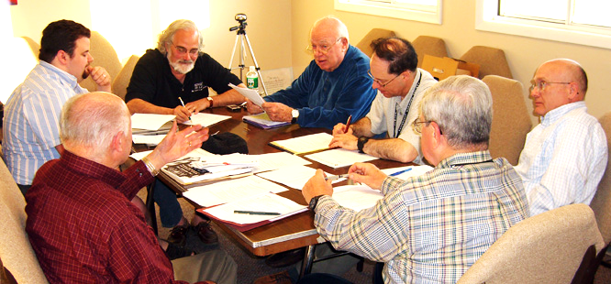
Shared Responsibilities
Ruling
“Remember your leaders, those who spoke to you the word of God… Obey your leaders and submit to them, for they are keeping watch over your souls, as those who will have to give an account.” Hebrews 13:7,17

Slide 9
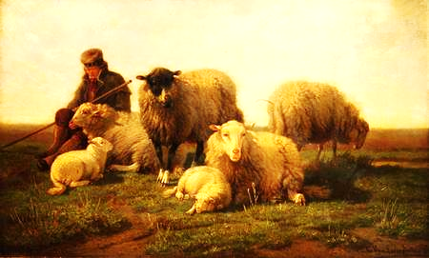
Shared Responsibilities
Shepherding
“So I exhort the elders among you, as a fellow elder and a witness of the sufferings of Christ, as well as a partaker in the glory that is going to be revealed: shepherd the flock of God that is among you, exercising oversight…not domineering over those in your charge, but being examples to the flock.” I Peter 5:1-3

Slide 10
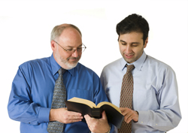
Shared Responsibilities
Teaching
“This is why I left you in Crete, so that you might put what remained into order, and appoint elders in every town as I directed you…For an overseer, as God's steward, must be above reproach…He must hold firm to the trustworthy word as taught, so that he may be able to give instruction in sound doctrine and also to rebuke those who contradict it.” Titus 1:5-9

Slide 11
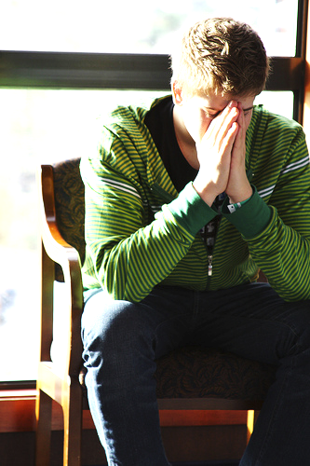
Shared Responsibilities
Discipline
“If your brother sins against you, go and tell him his fault, between you and him alone… But if he does not listen, take one or two others along with you, that every charge may be established by the evidence of two or three witnesses. If he refuses to listen to them, tell it to the church. And if he refuses to listen even to the church, let him be to you as a Gentile and a tax collector.” Matthew 18:15-17
“Is it not those inside the church whom you are to judge? God judges those outside. Purge the evil person from among you.’”
I Corinthians 5:12,13

Slide 12
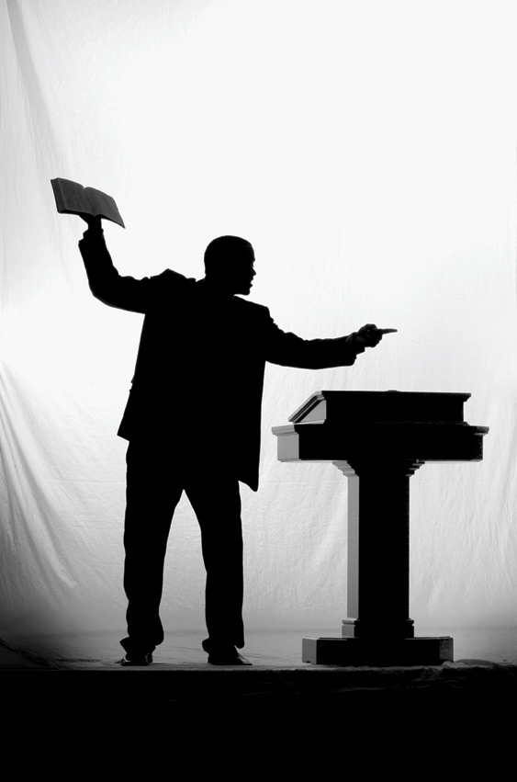
Different Responsibilities
“Let the elders who rule well be considered worthy of double honor, especially those who labor in preaching and teaching.”
I Timothy 5:17
“In the same way, the Lord commanded that those who proclaim the gospel should get their living by the gospel.”
I Corinthians 9:14

Slide 13
Male Leadership
“…there is no male and female, for you are all one in Christ Jesus. And if you are Christ's, then you are Abraham's offspring, heirs according to promise.” Galatians 3:28,29
Jesus: “…I am going to the Father, for the Father is greater than I.” John 14:28
“…those who are considered rulers of the Gentiles lord it over them, and their great ones exercise authority over them. But it shall not be so among you. But whoever would be great among you must be your servant…” Mark 10:42,43
“I do not permit a woman to teach or to exercise authority over a man; rather, she is to remain quiet. For Adam was formed first, then Eve; and Adam was not deceived, but the woman was deceived…”
I Timothy 2:12-14
“As in all the churches of the saints, the women should keep silent in the churches. For they are not permitted to speak, but should be in submission, as the Law also says.” I Corinthians 14:33,34

Slide 14
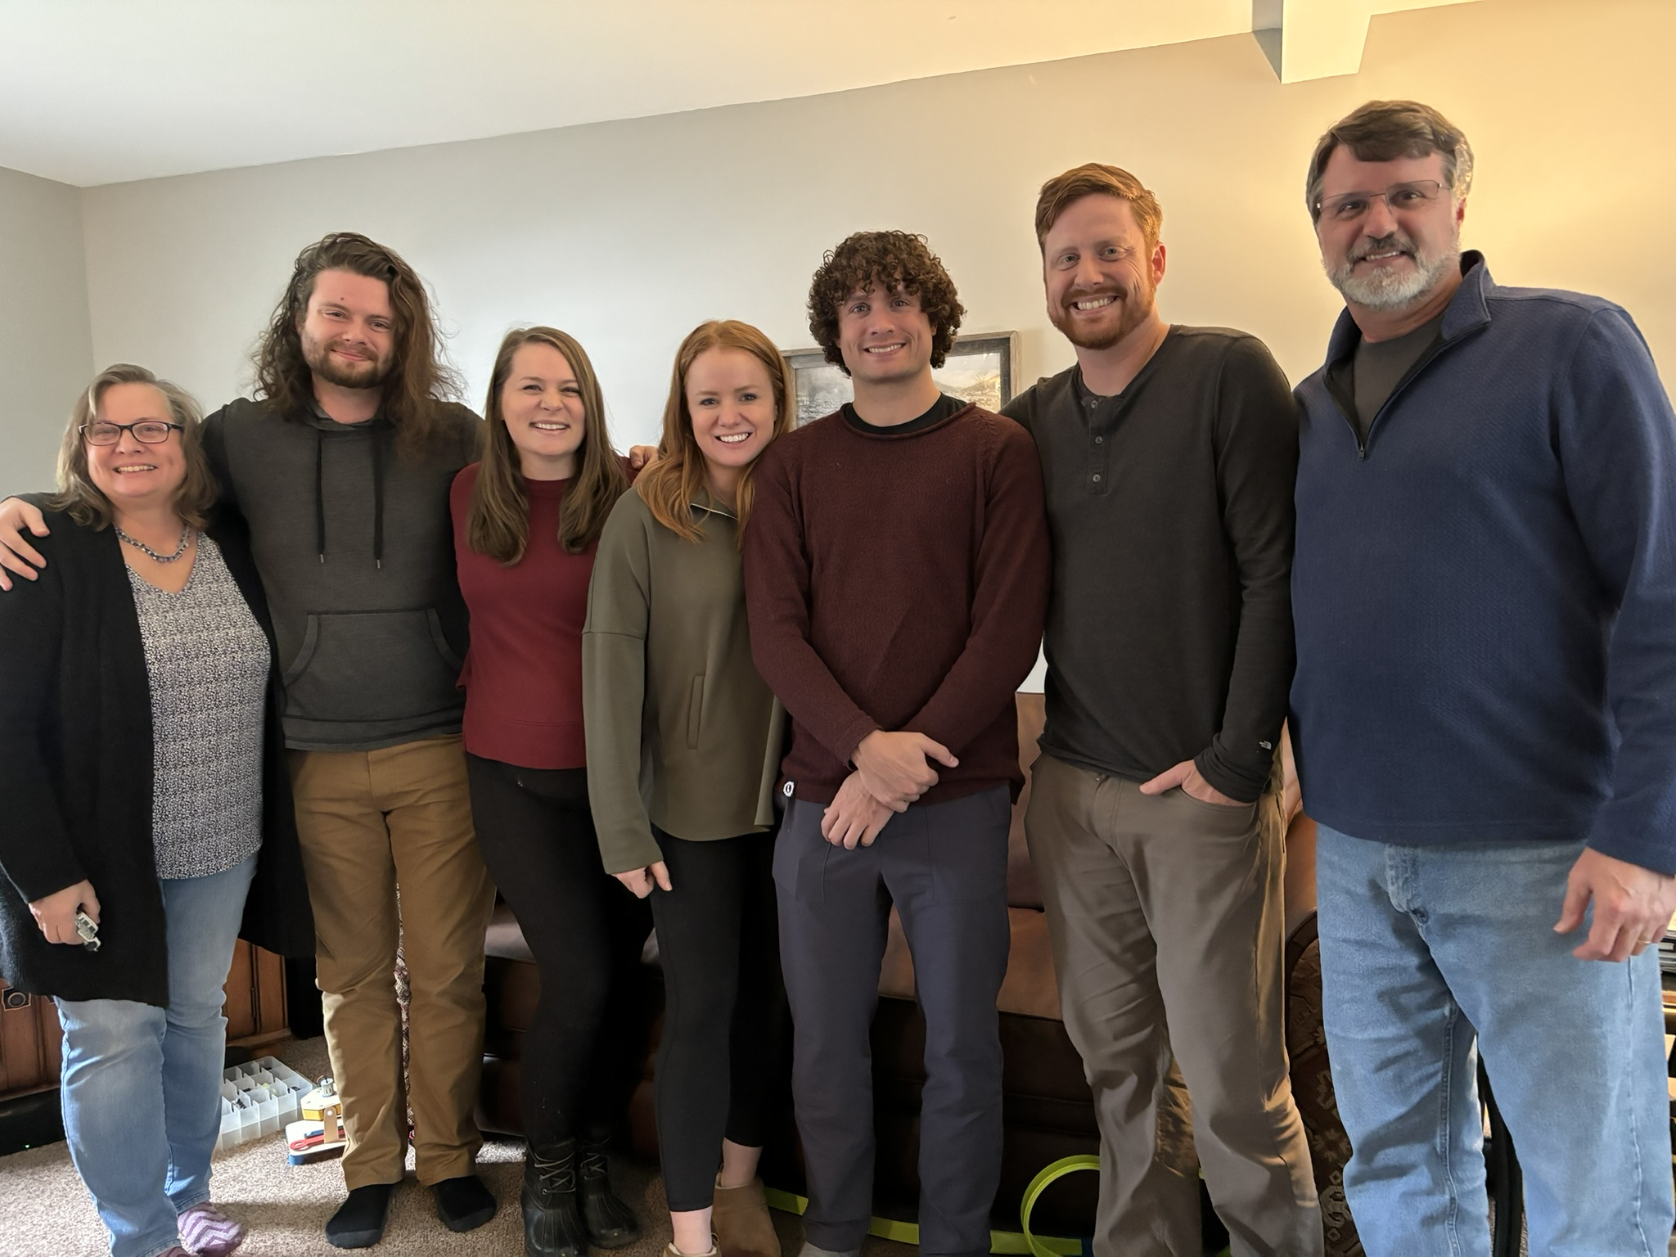
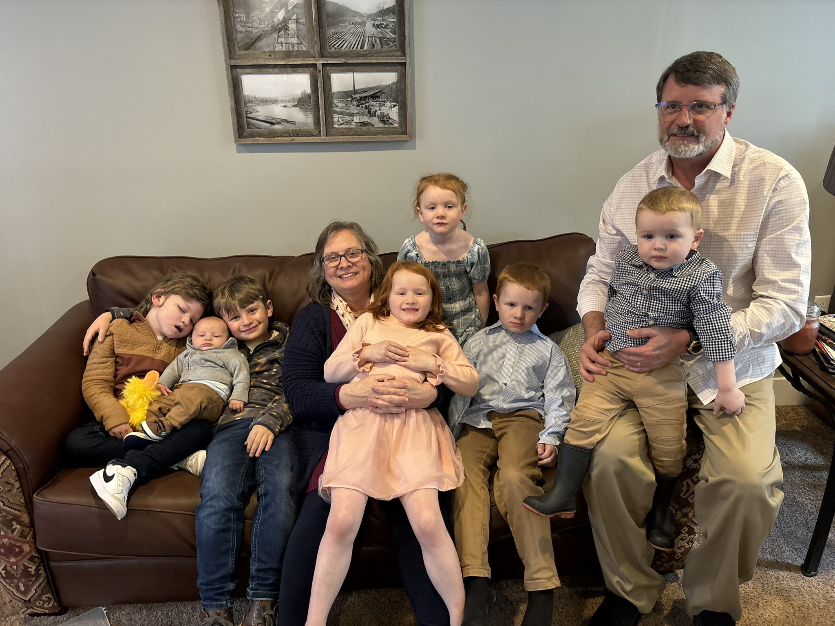
Our Senior Pastor
In March of 2012 Rev. Dan Kiehl was called to be the Pastor of Oakwood.
He has been a pastor since 1987, serving previously churches in Rimersburg, PA, Shawnee, KS, and West Chester, PA.
He is a graduate of Geneva College and Reformed Presbyterian Theological Seminary in Pittsburgh.
Dan and his wife Suzanne have 5 adult children and 9 grandchildren.

Slide 15
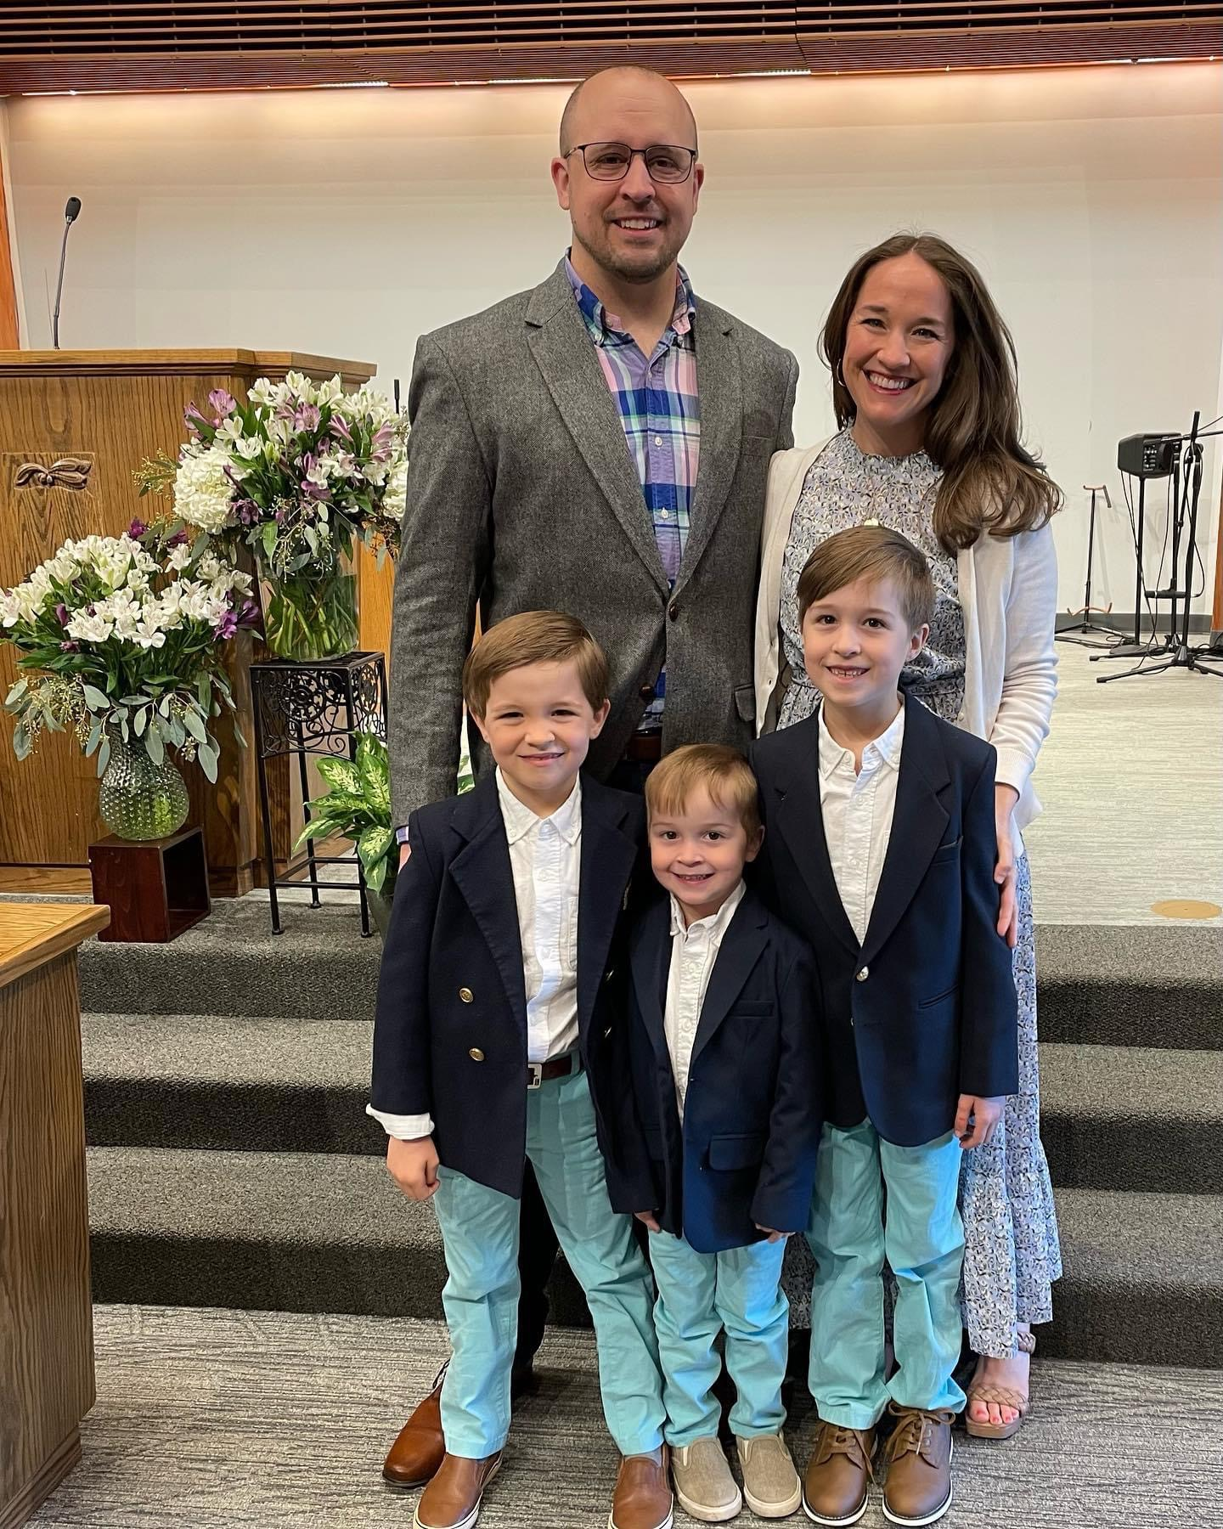
Our Associate Pastor / Youth Pastor
Rev. Ben Lee became an assistant pastor at Oakwood in January 2020
He graduated from Taylor University and The Southern Baptist Theological Seminary
He previously served as Pastor of Bald Eagle Baptist Church in Port Matilda
He and his wife Maggie have three children – Graeme, Haddon, and Teddy

Slide 16
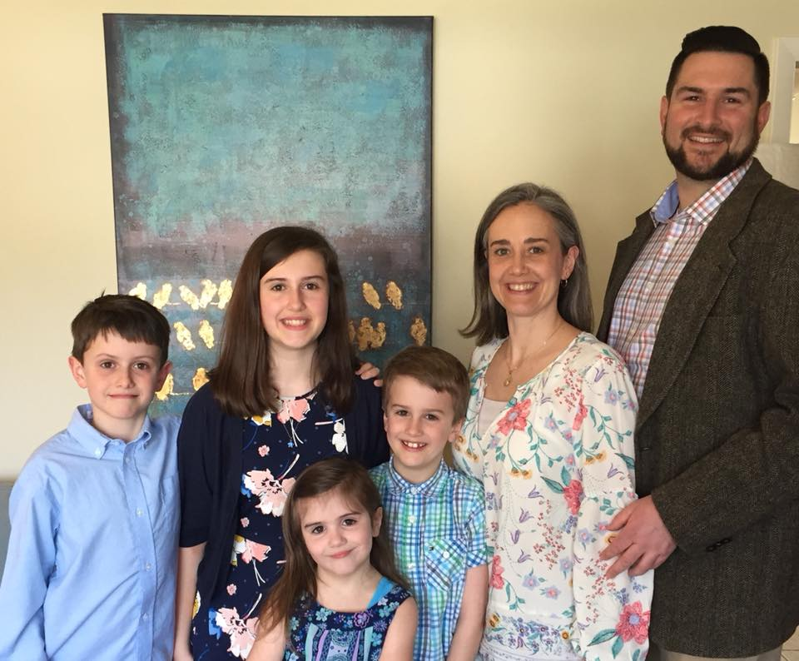
Our Associate Pastor / Church Planter
Rev. Owen Hughes became the Assistant Pastor at Oakwood in March of 2017
He graduated from Grove City College and Reformed Theological Seminary
He taught and served as part of a missions team in China from 2003-2005
He previously served as an assistant pastor in Melbourne, Florida
He and his wife Amber have four children – Emma, Griffin, Myles, and Ann

Slide 17
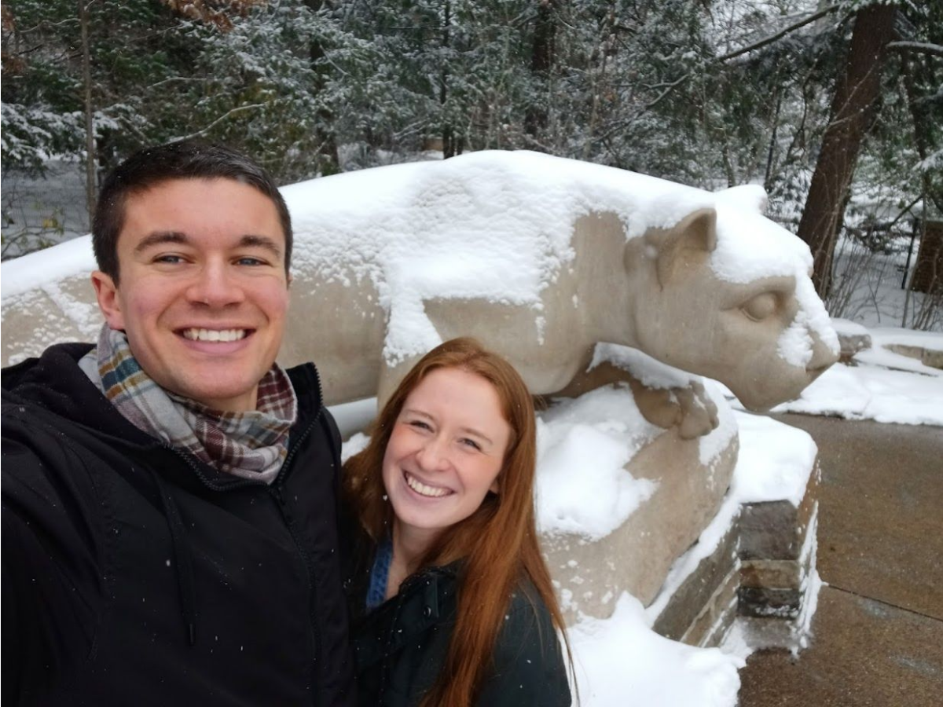
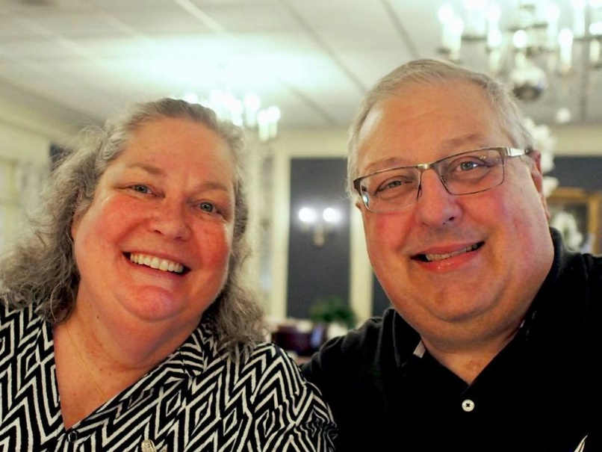
Our RUF and RUF-I Pastors
RUF started at Penn State in 1995, and has had a campus minister there continuously since 2003
The current RUF Campus Pastor is Rev. Cam Smith, but Matt Dabiero will take over in this June, when moves back with his wife Joanna
The current RUF-International Campus Pastor is Rev. Richard Smith, who moved to State College from Georgia in 2015

Slide 18
Ruling Elders
Those elders who are not Teaching Elders are called Ruling Elders. (I Timothy 5:17,18)
These men are elected by the congregation to direct the congregational life in all aspects, but specifically the spiritual well-being of the flock
We currently have 7 active Ruling Elders and 2 who are honorably retired (“Elder Emeritus”)

Slide 19
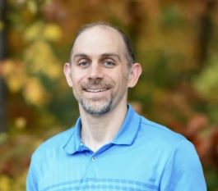
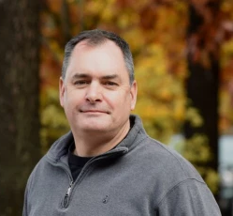
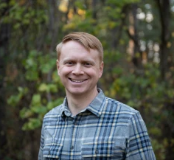
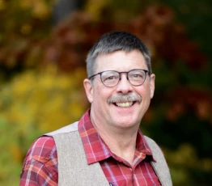
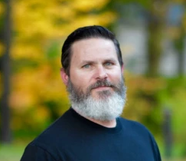
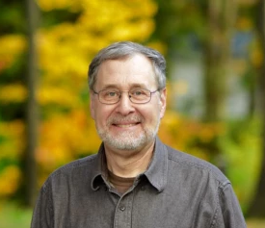
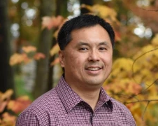
Ruling Elders of Oakwood
Jeremy Amaismeier, Conal Carr, Brian Roberg, Dave Borch
Doug Sharp, Tim Eshelman, Ling Rothrock

Slide 20
A Connectional Church
“…after Paul and Barnabas had no small dissension and debate with them, Paul and Barnabas and some of the others were appointed to go up to Jerusalem to the apostles and the elders about this question. So, being sent on their way by the church, they passed through both Phoenicia and Samaria… The apostles and the elders were gathered together to consider this matter. And after there had been much debate… [Peter, Barnabas, Paul, and James speak to the assembly] …Then it seemed good to the apostles and the elders, with the whole church, to choose men from among them and send them to Antioch with Paul and Barnabas. They sent Judas called Barsabbas, and Silas, leading men among the brothers, with the following letter…” Acts 15

Slide 21
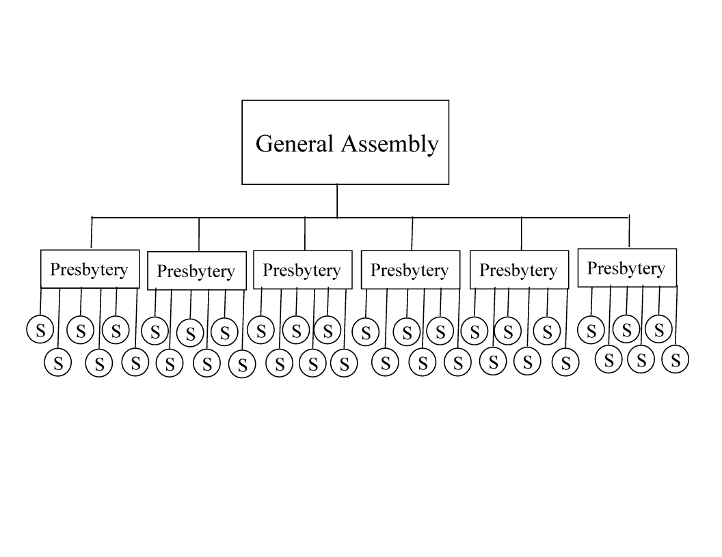
The Courts of the Church

Slide 22
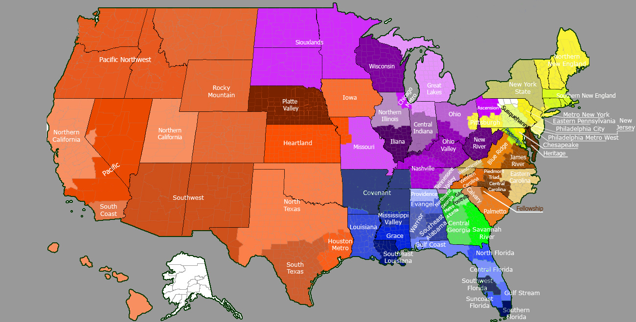
PCA Presbyteries

Slide 23
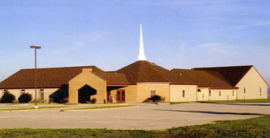
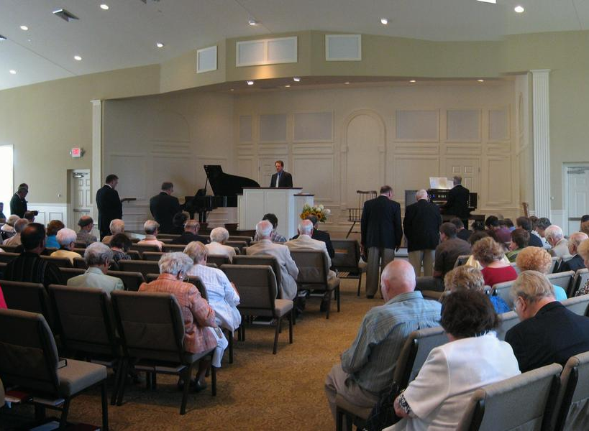
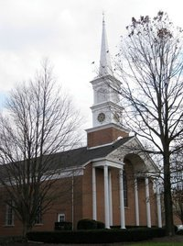
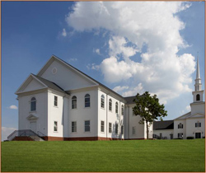
The Churches of Susquehanna Valley Presbytery
Carlisle Reformed PCA, Carlisle, PA
Manor PCA, Cochranville, PA
Reformed PCA, Ephrata, PA
Hanover Valley PCA, Hanover, PA
Trinity PCA, Harrisburg, PA
Second City Church, Harrisburg, PA
Harvest PCA, Lancaster, PA
Westminster PCA, Lancaster, PA
Wheatland PCA, Lancaster, PA
New Covenant Fellowship, Mechanicsburg, PA
Bethany PCA, Oxford, PA
Faith Reformed PCA, Quarryville, PA
Hope Reformed PCA, Shippensburg, PA
Oakwood PCA, State College, PA
Bellefonte PCA (Mission), Bellefonte, PA
Providence PCA, York, PA
New Life PCA, York, PA
St. Stephen Reformed, New Holland, PA
Proclamation PCA, Elizabethtown, PA
Redeemer PCA, Chambersburg, PA
Christ Reformed Church (Mission), Alexandria, PA
Hershey PCA, Hershey, PA
Lebanon Valley PCA (Mission), Cleona, PA

Slide 24

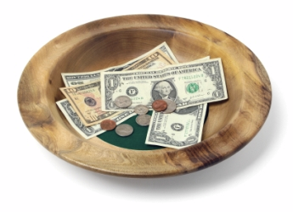
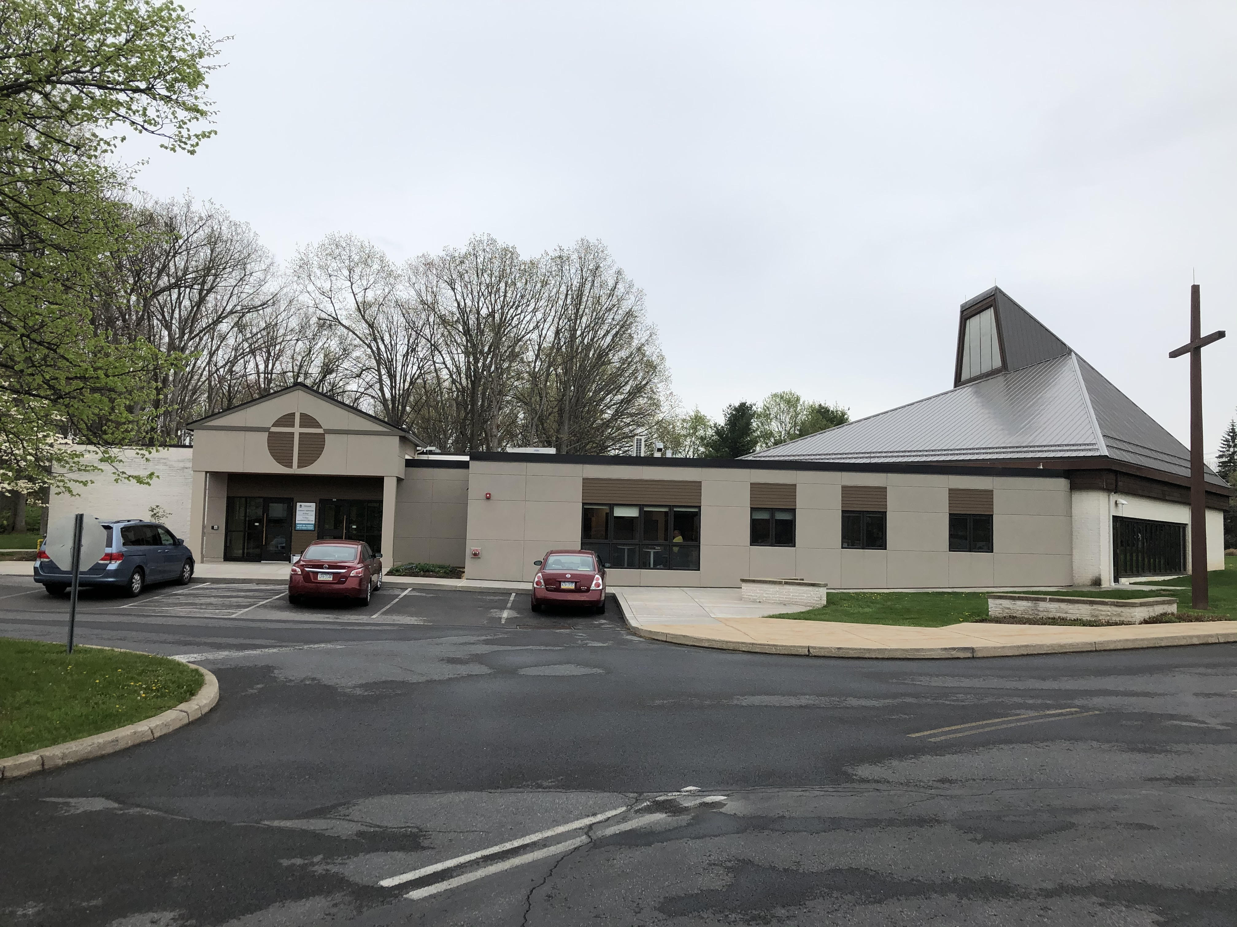
Deacons
In Acts 6:1-6 the Apostles created a class of officers which would deal more specifically with the material needs of the congregation
Deacons have the delegated responsibilities of leading our mercy ministries, and overseeing the stewardship of our property and financial resources
Oakwood currently has 6 Deacons

Slide 25
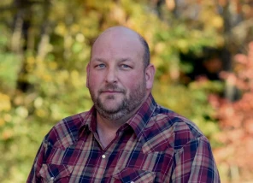
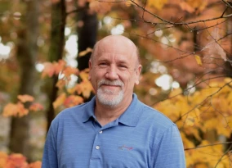
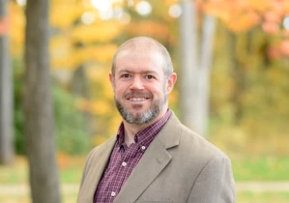
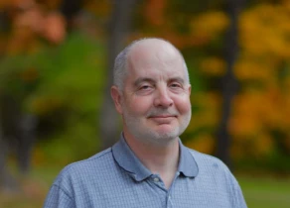
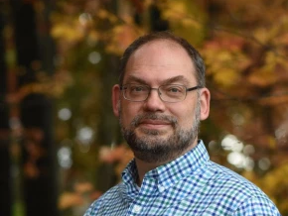
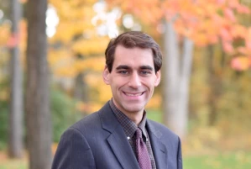
Deacons of Oakwood
John Ewing, Jim Bennett, Greg Sinsley,
Don Garbrick, Don Smith, Mark Jackson

Slide 26
